Slide 1



welcome

Slide 2



ROADSIDE SCENARIO
Presented by:
Shariful islam sajib sarker id: 2125051016
Mehadi hasan id: 2125051003
Nibir dewan id: 2125051020

Slide 3
INTRODUCTION
The roadside scenario project aims to simulate a typical scene along a road, showcasing various elements commonly found in such environments.

Slide 4


OBJECTIVES
To create a visually engaging representation of a roadside scene using graphics.h.
To demonstrate the capability of graphics.h in rendering realistic environments.

Slide 5


PROJECT WORK DESCRIPTION
01
The project utilizes graphics.h library in C++ to draw and animate various components of the roadside scene.
02
Components include roads, vehicles, buildings, trees, and other objects commonly found alongside roads.
03
Different graphical functions are used to create and animate each element, providing a static representation of a roadside scenario.

Slide 6



GRAPHICAL FUNCTIONS
line(): Draws a line between two specified points.
circle(): Draws a circle with a specified center and radius.
rectangle(): Draws a rectangle with specified coordinates.
ellipse(): Draws an ellipse with a specified center and radii.
setcolor(): set color of the line
setfillstyle(): set color of the specified area
floodfill(): select the for coloring

Slide 7
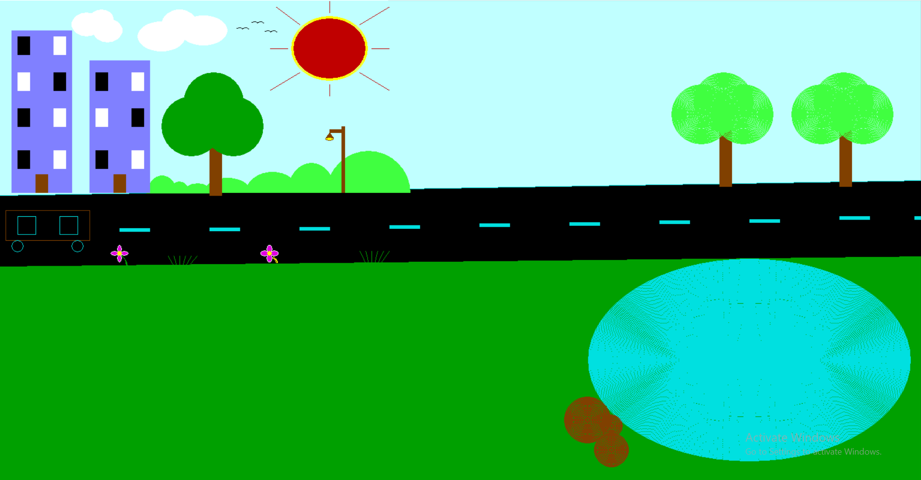

project presentation
March

Slide 8


LIMITATIONS
graphics.h is a basic graphics library and may not support advanced features like realistic textures, shading, or complex animations.
The project may only run on systems supporting the BGI graphics driver used by graphics.h, limiting its portability.

Slide 9

CONCLUSION
The roadside scenario project demonstrates the potential of graphics.h library in creating simple yet visually appealing graphical representations.
While it may have limitations, it serves as a starting point for exploring basic graphics programming and understanding fundamental concepts of computer graphics.

Slide 10


QUESTION AND ANSWER SESSION

Slide 11
Thank you

